Slide 1
Lecture 4: Numeric Types, Evaluating Expressions, Assignment Operators, Increment and Decrement Operators
Reading: Chapter 2, 2.9, 2.11, 2.13 - 2.15, 2.17 - 2.18

Slide 2
Homework #1 Review

Slide 3
Problem #1
public class
FixMyCodeStructure{public static void
main(String[] args){System.out.println
("I hate trying to read");System.out.println("unformatted Java code."); System.out.
println("Indentation and spacing");System.
out.println("make me so very happy!");
}
}
public class FixMyCodeStructure
{
public static void main(String[] args)
{
System.out.println("I hate trying to read");
System.out.println("unformatted Java code.");
System.out.println("Indentation and spacing");
System.out.println("make me so very happy!");
}
}

Slide 4
Problem #2
public class SoManyErrors
{
public static main(String[] args)
{
System.out.println("Being able to find errors in a program is challenging.");
System.out.println("Can you find all of them?);
System.out.println("12 divided by 3 is: ");
System.out.println(12/3)
System.out.println("10 divided by 2 is: ");
System.out.println(10/.2);
System.out.println("100 divided by 0 is: ");
System.out.println(10/0);
}
}
Syntax Error: Missing the word void
Syntax Error: Missing a closing quote.
Syntax Error: Missing a semi-colon.
Logic Error: Should be 10/2 not 10/.2
Runtime Error: You cannot divide by zero.
Syntax Error: Missing a closing brace.

Slide 5
Problem #3
Create a new .java file named WelcomeTest. Write a program that displays the
message “Welcome to Programming I" five times.
public class WelcomeTest
{
public static void main(String[] args)
{
System.out.println("Welcome to Programming I");
System.out.println("Welcome to Programming I");
System.out.println("Welcome to Programming I");
System.out.println("Welcome to Programming I");
System.out.println("Welcome to Programming I");
}
}

Slide 6
Numeric Data Types
Java has six numeric types.
The compiler allocates memory space for each variable or constant according to its data type.
Each data type has a range of values.
You learned about two numeric types last lecture: int and double
int: -2147483648 to 2147483647, storage size of 32 bits
double: -1.79E308 to -4.9E-324, 4.9E-324 to 1.79E308, storage size of 64 bits

Slide 7

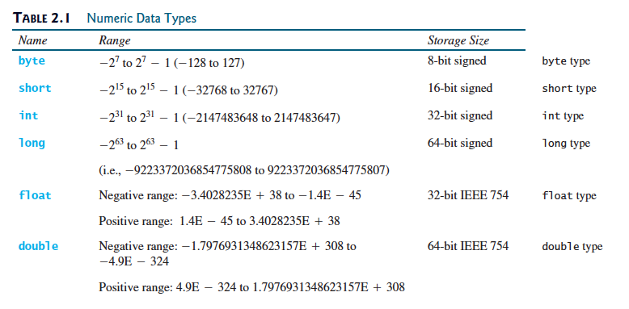
The real reason you can’t do this:
int number = 3.14;
A double requires 64 bits of storage and an integer
type only holds 32 bits!
In fact, with all numeric data types, you cannot assign a
bigger data type to a smaller data type.
However, you can assign a
smaller data type to a larger
data type.

Slide 8
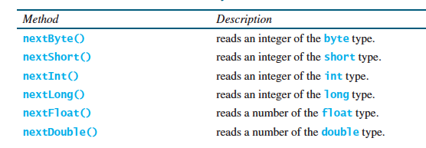
Numeric Types and Input
You can read in user input for each of these numeric types. But you have to match things up!!
Scanner keyboard = new Scanner(System.in);
byte myNumber;
System.out.print(“Enter a number in binary”);
myNumber = keyboard.nextByte();
Scanner keyboard = new Scanner(System.in);
byte myNumber;
System.out.print(“Enter a number in binary”);
myNumber = keyboard.nextInt();

Slide 9
More Examples
You only have to
create the keyboard
scanner once! And
then you can use it as
many times as you
want.
Scanner keyboard = new Scanner(System.in);
byte byteNumber;
System.out.print(“Enter a binary value: ”);
byteNumber = keyboard.nextByte();
short shortNumber;
System.out.print(“Enter a short value: ”);
shortNumber = keyboard.nextShort();
long longNumber;
System.out.print(“Enter a long value: ”);
longNumber = keyboard.nextLong();
float floatNumber;
System.out.print(“Enter a float value: ”);
floatNumber = keyboard.nextFloat();

Slide 10
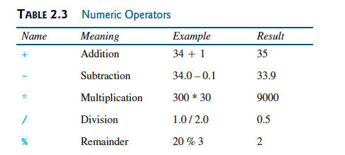
Numeric Operators
The remainder (aka mod
for modulus) operator: %
Ex: 20 % 3 = 2
Finds the remainder when you divide
the first number by the second number.

Slide 11
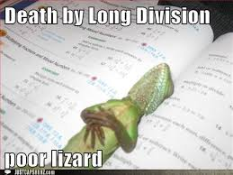
More Remainder Examples
Ex: -20 % 3
Ex: -20 % -3
Ex: 20 % -3

Slide 12
Division
When you divide an
integer by another
integer, Java always
rounds down.
public class DivisionTest
{
public static void main(String[] args)
{
int num1 = 3/2;
System.out.println(num1);
double num2 = 3/2;
System.out.println(num2);
double num3 = 3.0/2;
System.out.println(num3);
}
}
When you divide an
integer by another
integer, Java always
rounds down. After
it does the division, then
it makes it a decimal.
As long as one of the
numbers is a decimal,
then the result is a
decimal.
1
1
1.5

Slide 13
Division (cont.)
As long as one of the
numbers is a decimal,
then the result is a
decimal.
public class DivisionTest
{
public static void main(String[] args)
{
double num1 = 3/2.0;
System.out.println(num1);
double num2 = 3.0/2.0;
System.out.println(num2);
int num3 = 3.0/2;
System.out.println(num3);
}
}
You can’t assign a
decimal to an integer
type variable.
1.5
1.5
DivisionTest.java:9: error: incompatible types: possible lossy conversion
from double to int int num3 = 3.0/2;

Slide 14

Example
Problem: Write a program that asks the user for an integer in seconds and then
converts the value to minutes and prints the minutes with the remaining seconds.
Output:
How do you convert seconds to minutes?
Divide the number of seconds by 60 (bc there
are 60 seconds in a minute).
How do you get the remaining seconds?
Use the remainder operator! Take the number
of seconds and use it with the remainder
operator and 60 (seconds per minute), i.e.
num secs % num minutes

Slide 15
import java.util.Scanner;
public class DisplayTime
{
public static void main(String[] args)
{
Scanner keyboard = new Scanner(System.in);
int seconds;
System.out.print(“Enter an integer for seconds: ”);
seconds = keyboard.nextInt();
int minutes = seconds/60;
int remainingSecs = seconds % 60;
System.out.println(seconds + “seconds is ” + minutes +
“ minutes and ” + remainingSecs + “ seconds”);
}
}
Need this for input.
Need this for input.
Declare the variable for input
Ask the user for input.
Get the input and assign it the variable.
Get the number of minutes
Get the number of remaining
seconds

Slide 16
More math operations: Exponents!
What if you wanted to calculate the value of 4² ? 4 * 4
What if you wanted to calculate the value of 4²⁵ ?
We have to use a special Java library.
Math.pow(a,b) is used to calculate a^{b}
Math.pow(4,25) is used to calculate 4²⁵
Math MUST be capitalized
int value = Math.pow(4,25);

Slide 17


Operator Precedence for Mathematical Expressions
My Dear Aunt Sally
Please Excuse My Dear Aunt Sally
Exponents
Division
Subtraction
Parentheses
Addition
Multiplication
What is the value of:
3 + 4 * 4 ÷ 2
Read from left to right and do all
multiplication or division first:
If you said 14...
3 + 16 ÷ 2 = 3 + 8
Read from left to right and
do addition or subtraction:
3 + 8
= 11

Slide 18
Another Example
3 + 4 * 4 + 5 * (4 + 3) - 1
Parentheses first:
3 + 4 * 4 + 5 * 7 - 1
Multiplication/Division (left to right):
3 + 16 + 35 - 1
Addition (left to right):
54 - 1
Subtraction (left to right):
53
This is why it’s a good idea to use parentheses to make your mathematics clear.

Slide 19
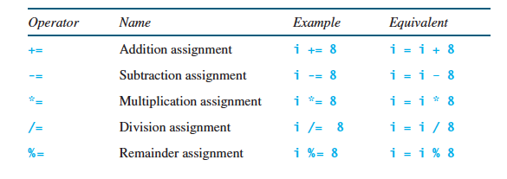
Augmented Assignment Operators
The operators +, -, *, /, and % can be combined with the assignment operator (=) to form augmented operators.

Slide 20
What do these augmented operators do?
int count = 1;
count = count + 1;
Memory
count = 1
X
2
Takes the value stored in count.
Adds 1 to it.
Re-assigns the new sum to count.
int count = 1;
count += 1;
Memory
count = 1
X
2
Takes the value stored in count.
Adds 1 to it.
Re-assigns the new sum to count.

Slide 21
More Examples
int count = 4;
count -= 2;
count *= 5;
count += 8;
count /= 3;
System.out.println(count);
Memory
count = 4
X
X
X
X
2
10
18
6
Note: In terms of operator precedence,
assignment operators happen after
everything else.
6

Slide 22
Increment and Decrement Operators
These are two shorthand operators that easily allow you to increase or decrease a variable by 1.
There are two types: postfix and prefix
You only have to learn postfix increment and decrement operators.
int count = 1;
count = count + 1;
Memory
count = 1
X
2
These do the same things!
int count = 1;
count++;
int count = 1;
count--;
The postfix increment operator
The postfix decrement operator

Slide 23

Numeric Type Conversions
Can you do this?
double dec = 3.14;
int num = dec;
No! You can’t assign a double to an integer.
What if I really, really, really wanted to??
double dec = 3.14;
int num = (int) dec;
This is also called type casting.
This is called a numeric type conversion
It MUST be in parentheses.
It MUST match the type on the left hand side
Notes:
Because of the loss when converting a decimal to a integer, there should be a very good reason for doing this.

Slide 24
Common Errors: Undeclared/Unused Variables
What is wrong with the following code?
double interestRate = 0.05;
double interest = interestrate * 45;
System.out.println(interest);
This variable has been declared and initialized, but never used.
This variable has not been declared or initialized. Capitalization matters in Java!
double interestRate = 0.05;
double interest = interestRate * 45;
System.out.println(interest);

Slide 25
Common Errors: Integer Overflow
What is wrong with the following code?
int value = 2147483647 + 1;
The largest value that can be stored in a variable of type int is 2147483647. The number 2147483648 will be too large to be stored in a value.
As a result, the actual value stored in the variable “overflows” and starts at the largest negative value (-21477483648).

Slide 26

Common Errors: Round-off Errors
A round-off error is the difference between the calculated approximation of a number and its exact mathematical value.
System.out.println(1.0 - 0.1 - 0.1 - 0.1 - 0.1 - 0.1);
This displays 0.5000000000000001, not 0.5
Calculations involving floating-point numbers are approximated because these numbers are not stored with complete accuracy.
Integers are stored precisely.

Slide 27

That’s all for today folks!
Read Chapter 2, Sections 2.9, 2.11, 2.13 - 2.15, 2.17 - 2.18.

